Slide 1
Adult income prediction
Radhi Priya J
1803583B
Project 2

Slide 2
INTRODUCTION
Data obtained from Kaggle; Adult Census Income
Predict whether a person makes $50K annually based on census data.

Slide 3
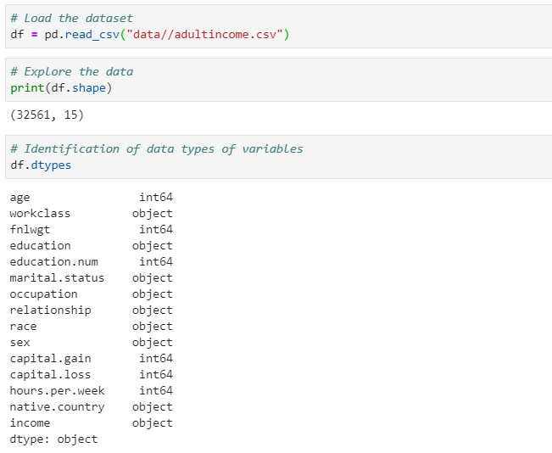
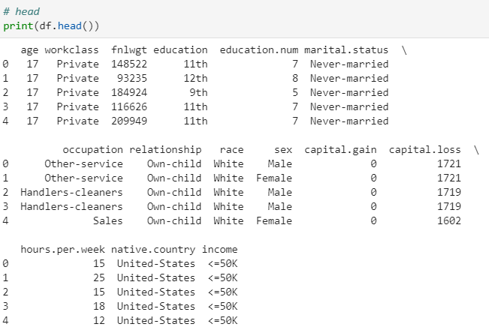
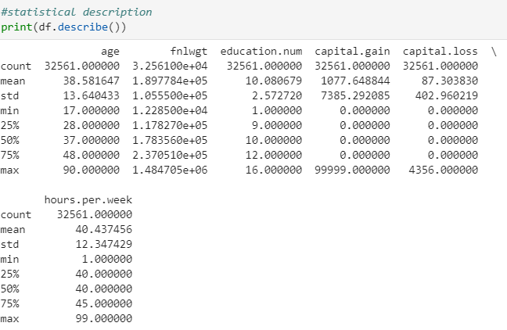


DATA EXPLORATION

Slide 4
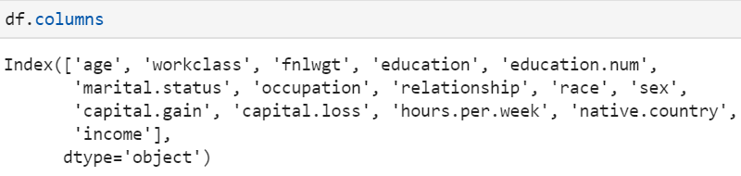
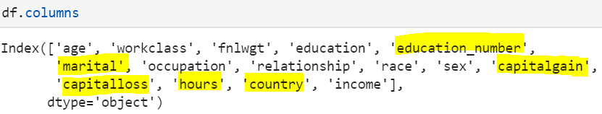
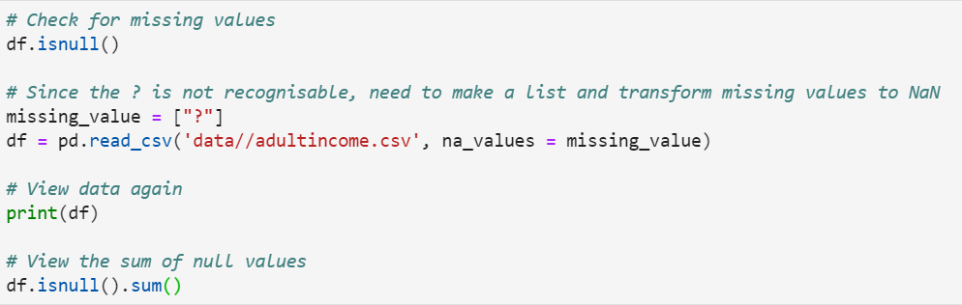
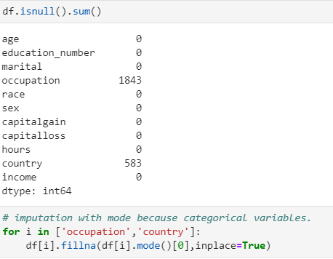
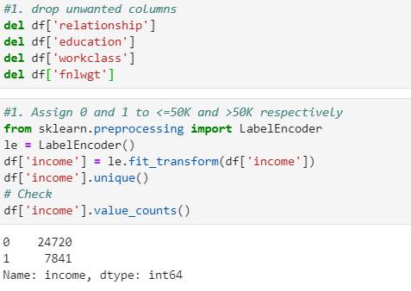
DATA preparation & FEATURE ENGINEERING
Rename some of the columns;
Check for missing values (?) and replace them with NaN;
Replace missing values for occupation and country columns with mode – cat cols
Drop unwanted columns and label encode income column

Slide 5
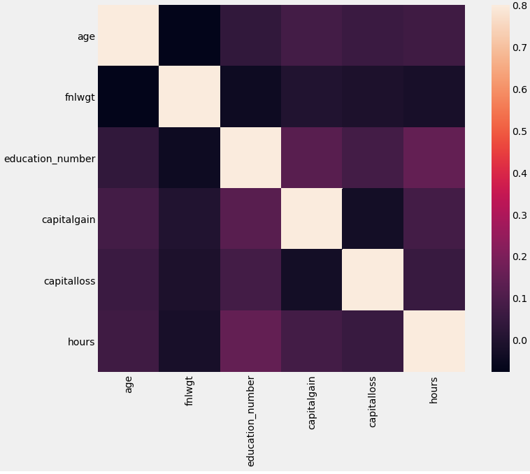
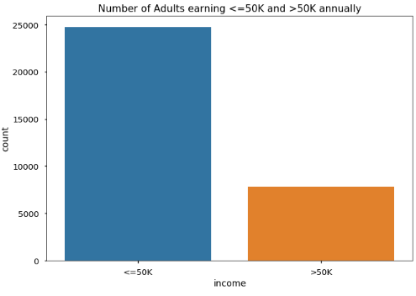
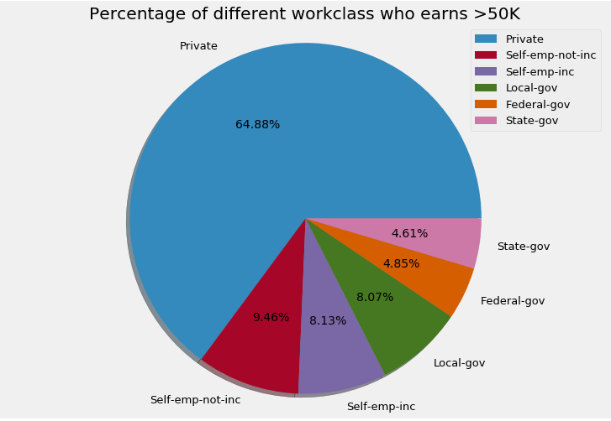
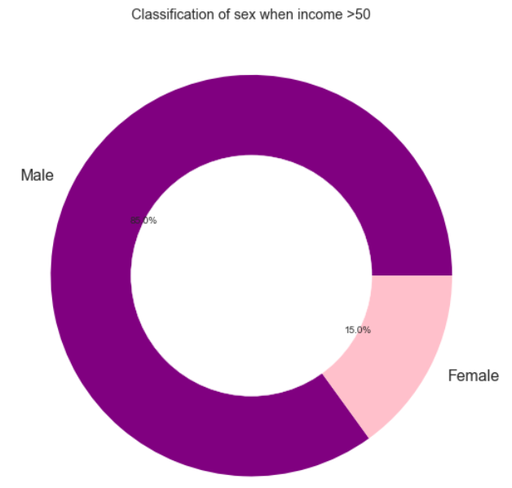
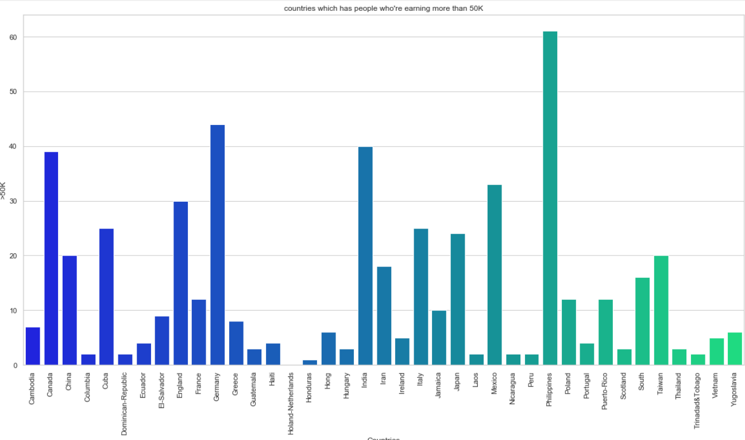
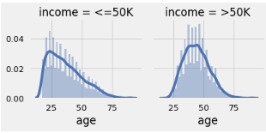
EXPLORATORY DATA ANALYSIS (EDA)

Slide 6
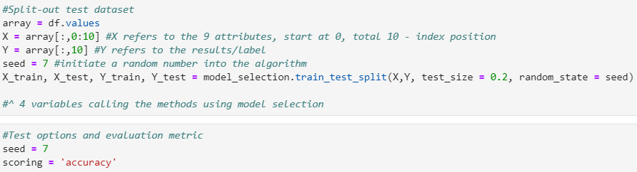
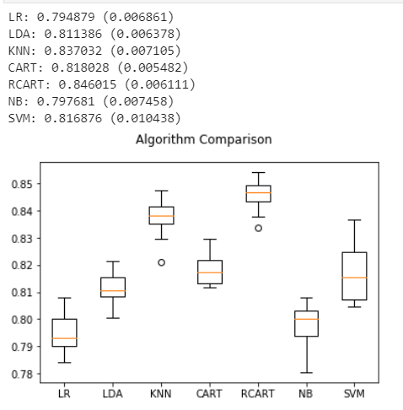
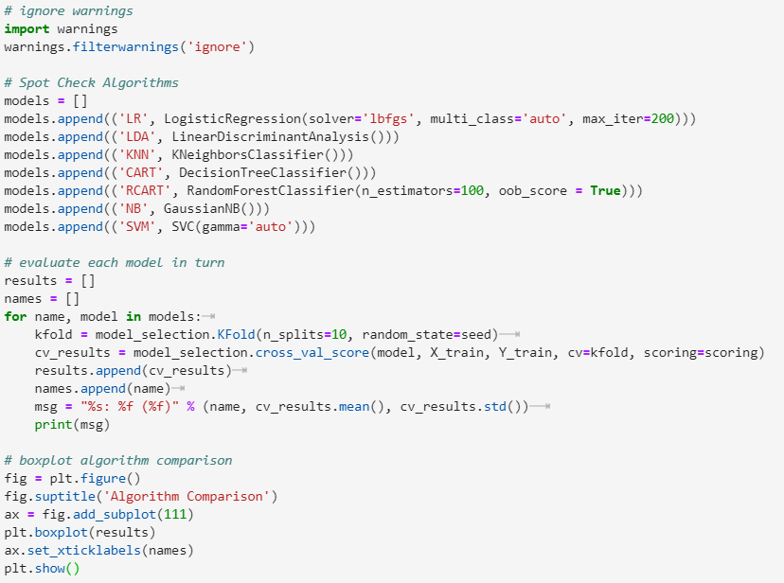
METHODS AND IMPROVEMENTS + results
Split into train and test set (80%, 20% respectively.
Results of models and Box plots for comparison
7 models, different parameters.

Slide 7
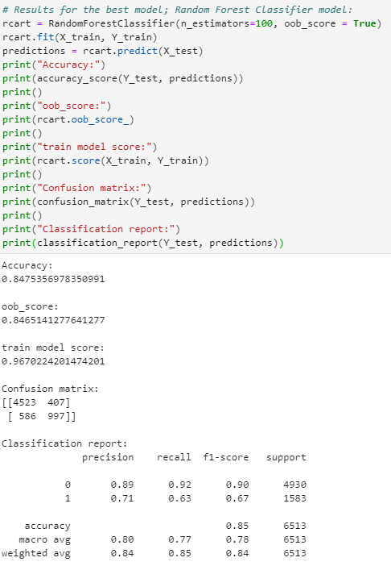
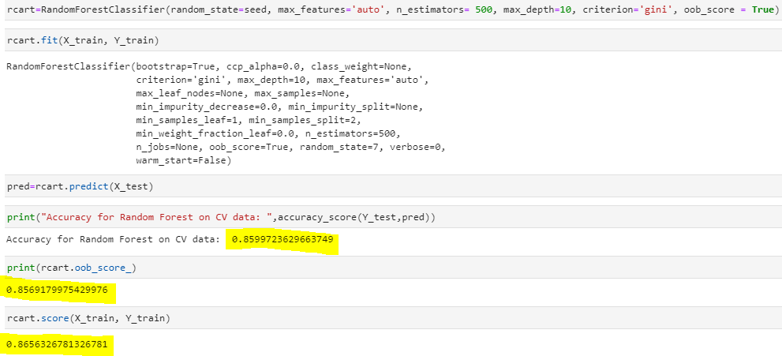
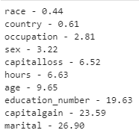
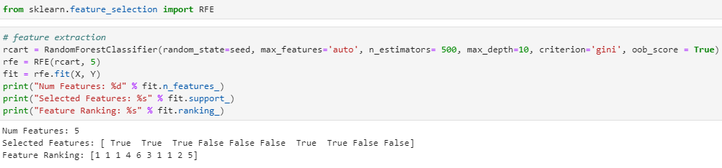
METHODS AND IMPROVEMENTS + results
After doing feature selection, here are the ranking of features:
After grid search, accuracy improved by 0.0.12.
Raw model
Extracted features from the best model ; random forest classifier
Age
Education_number
Marital
Capitalgain
capitalloss

Slide 8
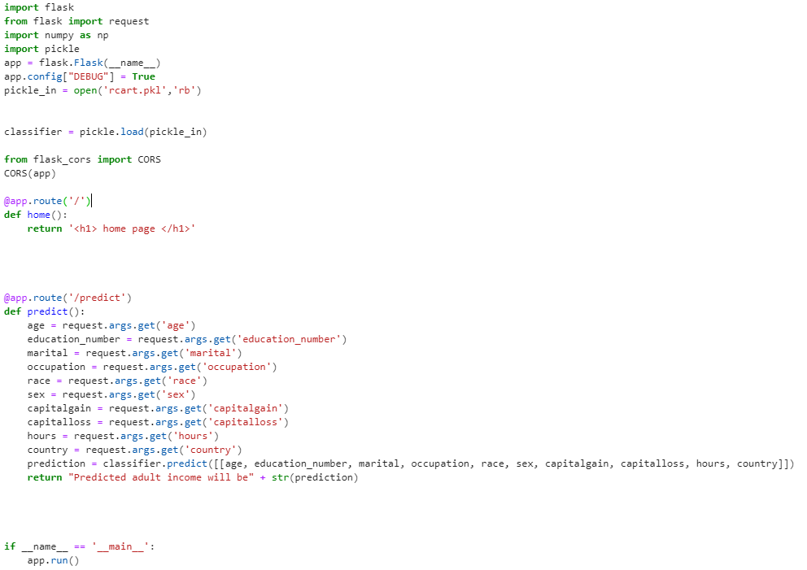
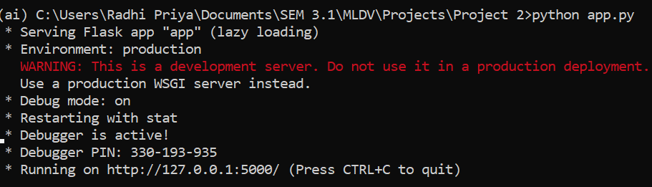
FLASK
Code
Terminal to run the app.py file.
Testing url with the input values.

Slide 9

CONCLUSION
Managed to have a better understanding of different machine learning algorithms as compared to the mindset I had whilst completing the first project.
More motivated to carry out machine learning tasks in a more neat and précised manner so as to enable better understanding for readers.
Carried out way more research to clarify doubts and misconcepts which were built overtime from the beginning of this module.

Slide 10
References
https://flask.palletsprojects.com/en/0.12.x/quickstart/#rendering-templates
https://towardsdatascience.com/understanding-confusion-matrix-a9ad42dcfd62
https://machinelearningmastery.com/feature-selection-machine-learning-python/
https://www.datacamp.com/community/tutorials/pickle-python-tutorial
https://towardsdatascience.com/what-is-out-of-bag-oob-score-in-random-forest-a7fa23d710
https://towardsdatascience.com/hyperparameter-tuning-the-random-forest-in-python-using-scikit-learn-28d2aa77dd74
https://python-graph-gallery.com/104-seaborn-themes/

